Slide 1
Kansas Respiratory Care Society
Mission Statement
The Kansas Respiratory Care Society is formed to: Educate, Advocate, and Promote the profession and practice of Respiratory Respiratory Care

Slide 2
Resources available to use for:
Health Fairs
Schools
Community activities
COPD screening
Lung Health and education
Smoking Cessation

Slide 3
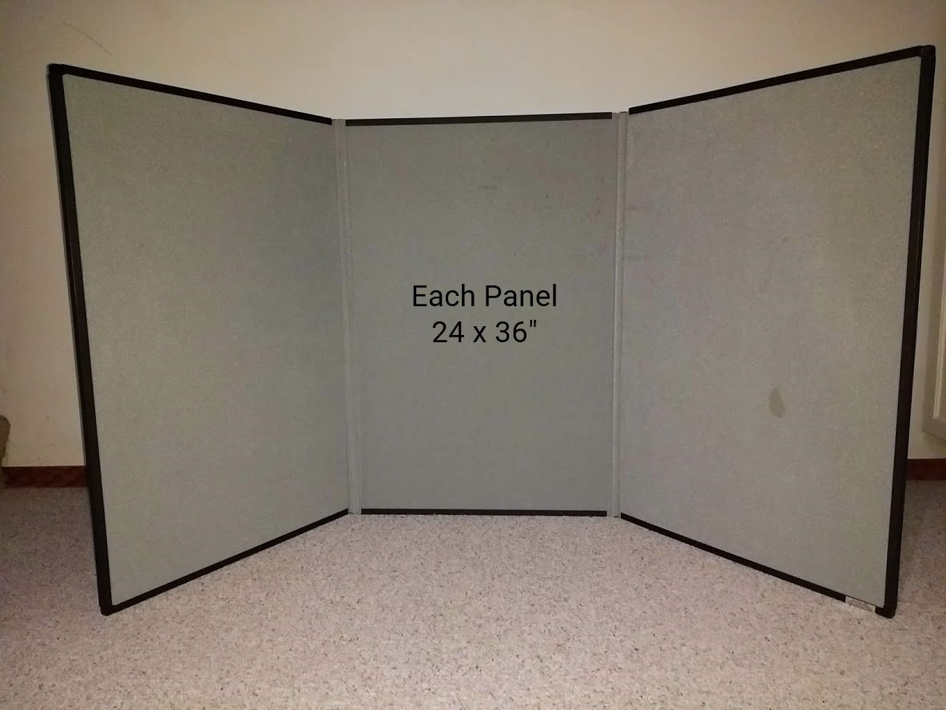
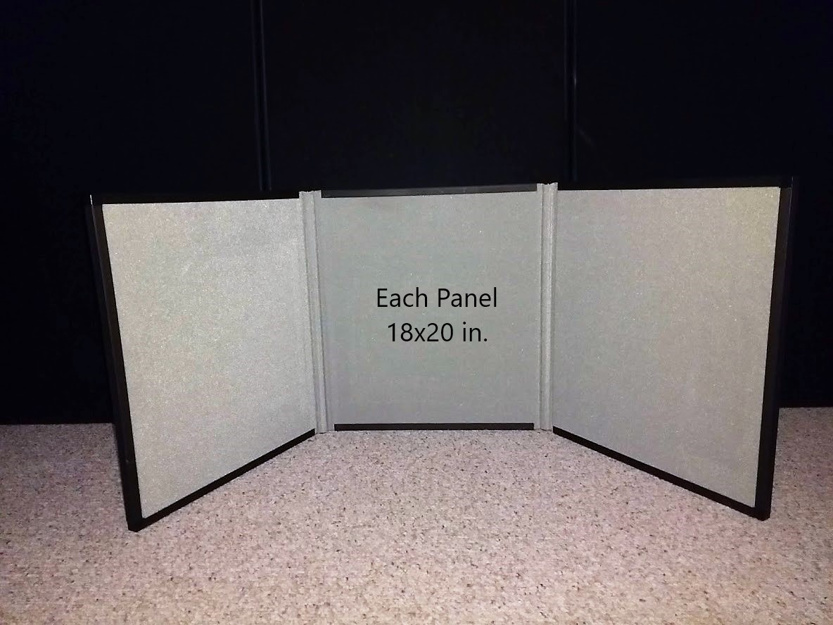
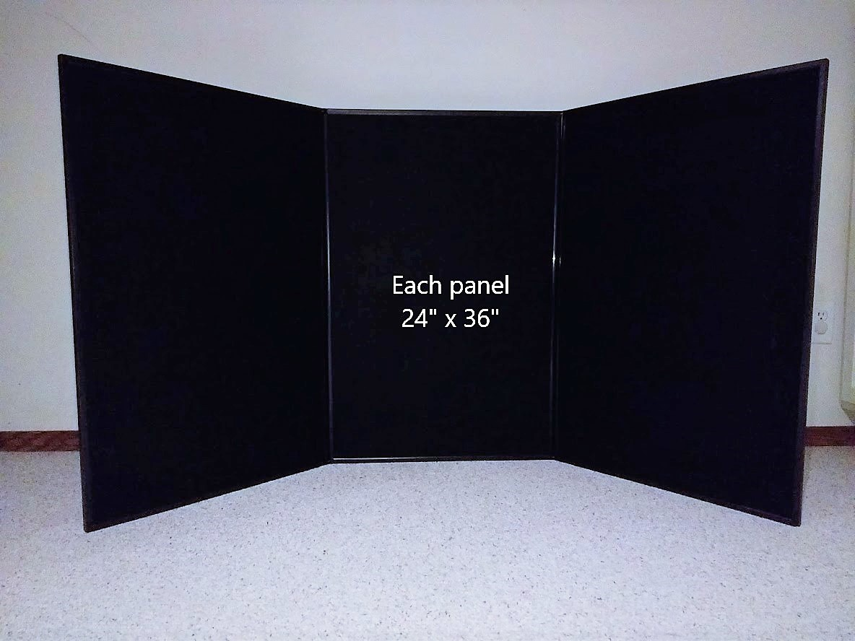
Felt Panel Boards

Slide 4
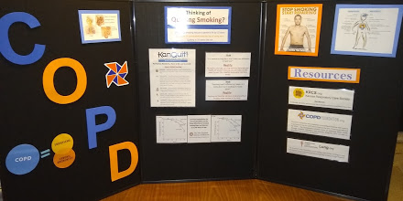
Example of Customized backdrop
Below is an example of the large black felt panel backboard, customized for a health fair.
The information pages attached to the board are simply papers printed from a desktop computer, and the letters are cut from foam sheets (available from many discount stores and craft stores)
All of these are attached to the backboard with Velcro, and can easily be moved around or changed to ‘customize’ the backboard however you desire.

Slide 5
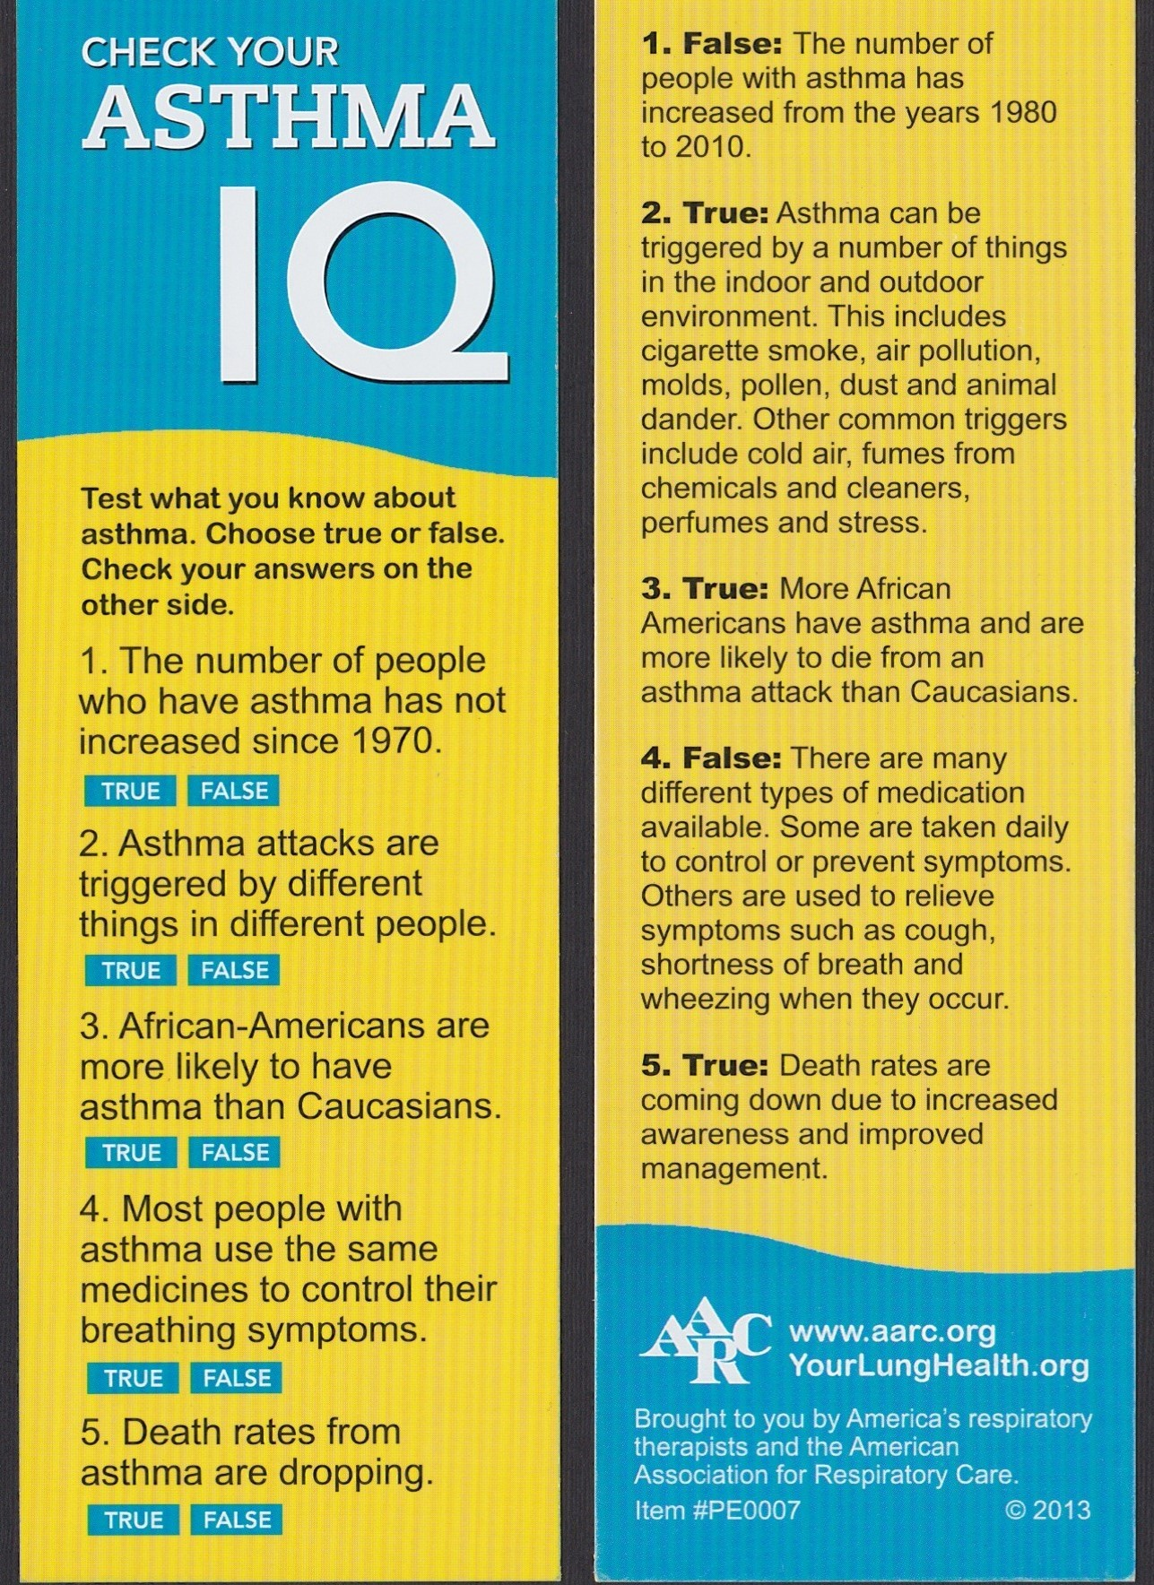
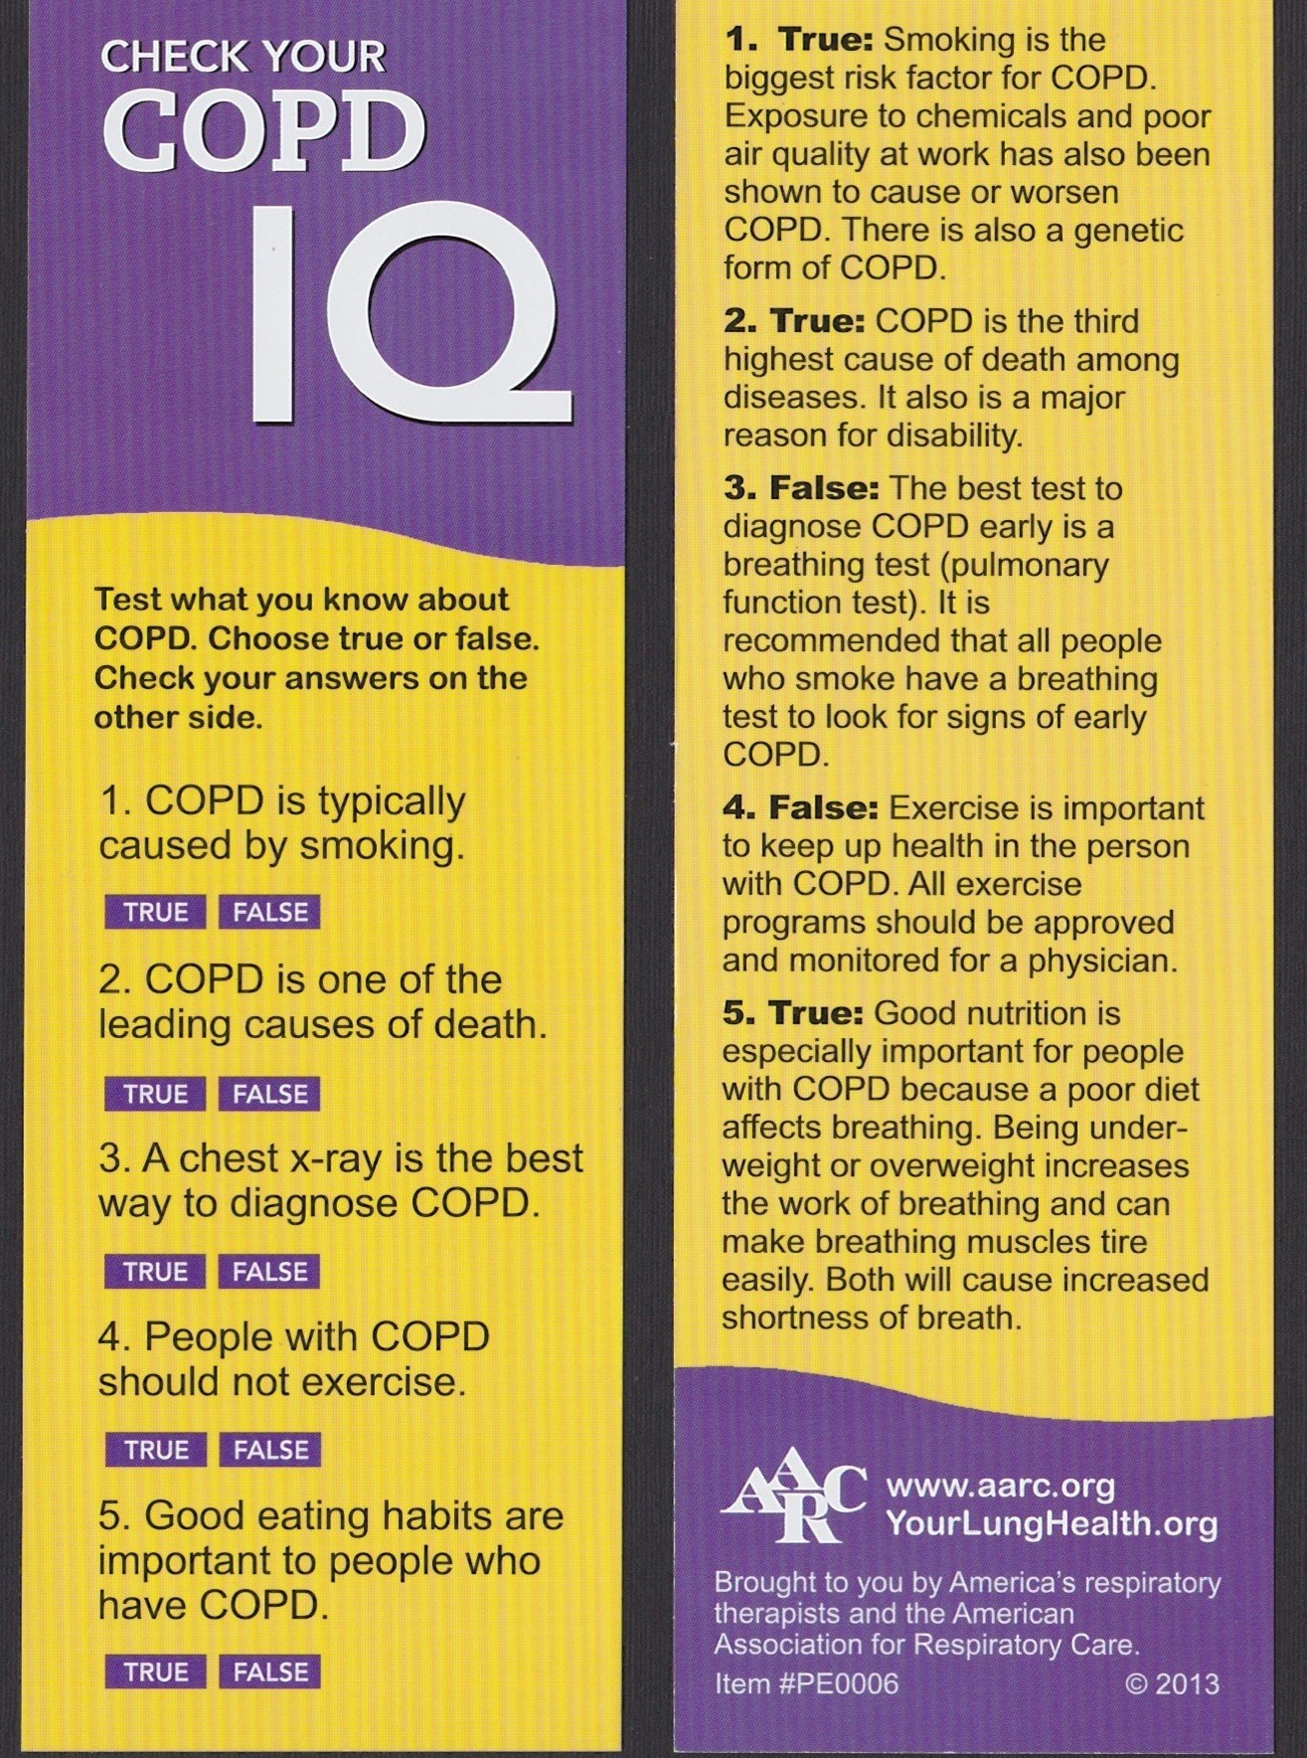
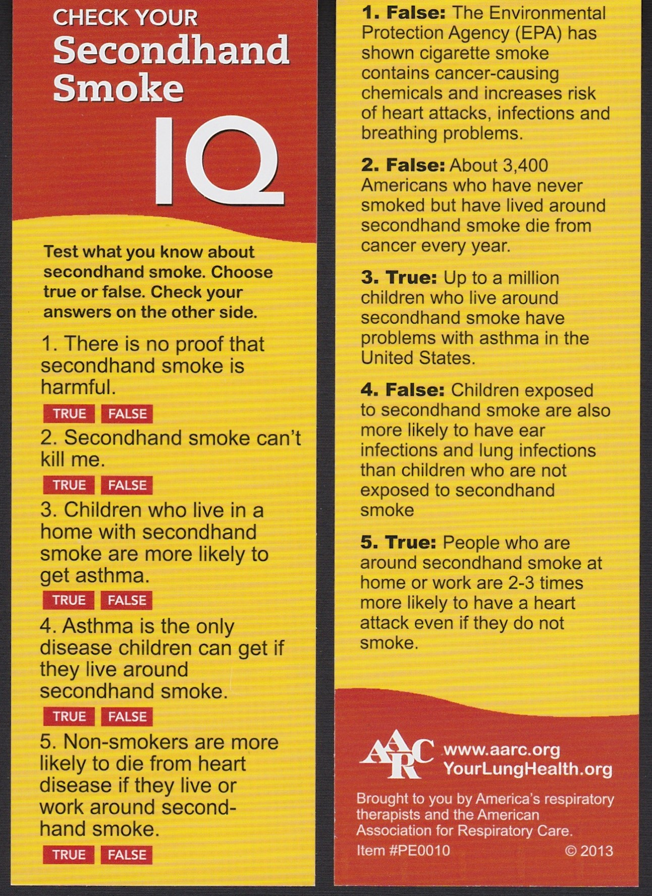
BOOKMARKS

Slide 6
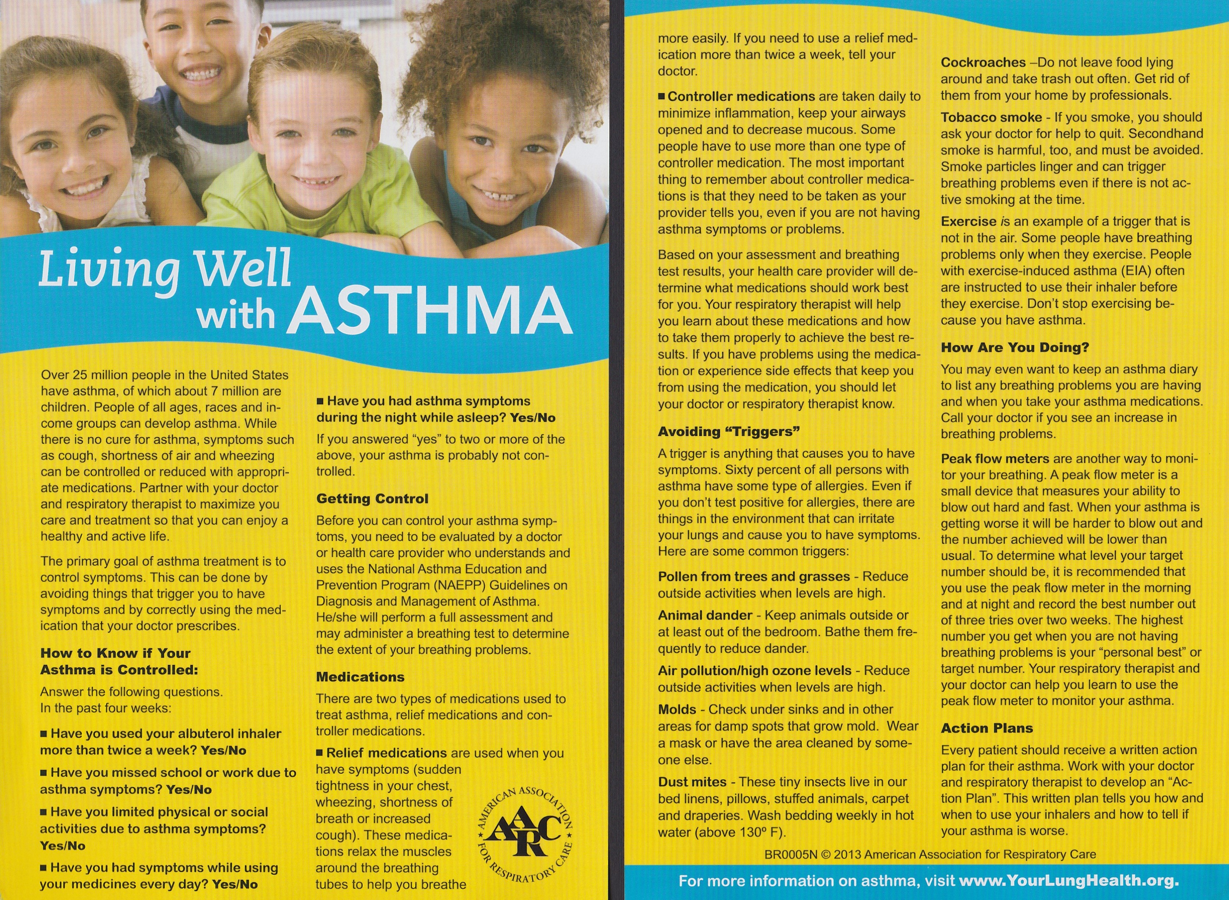
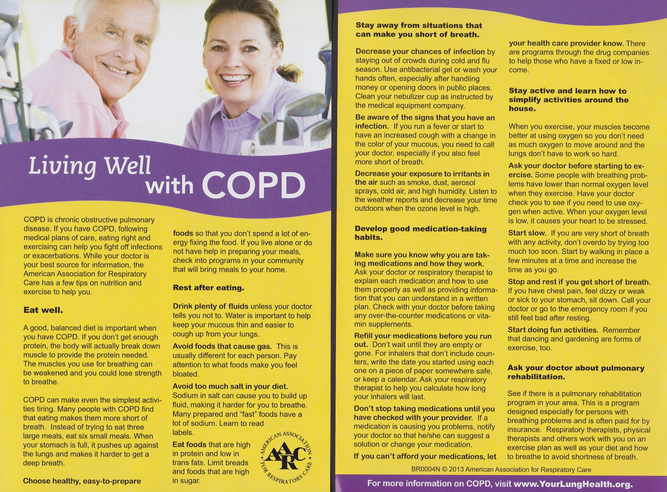
Brochures

Slide 7
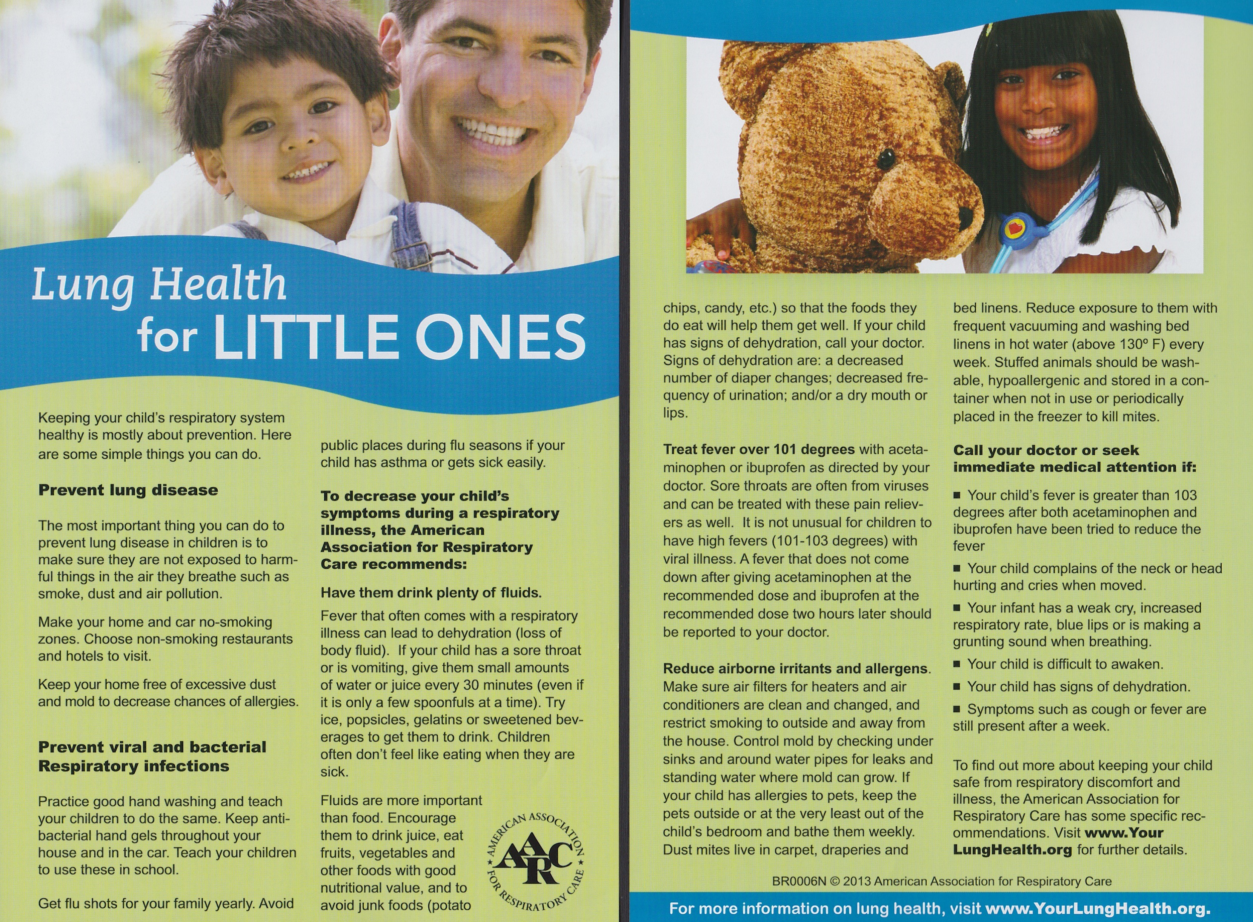
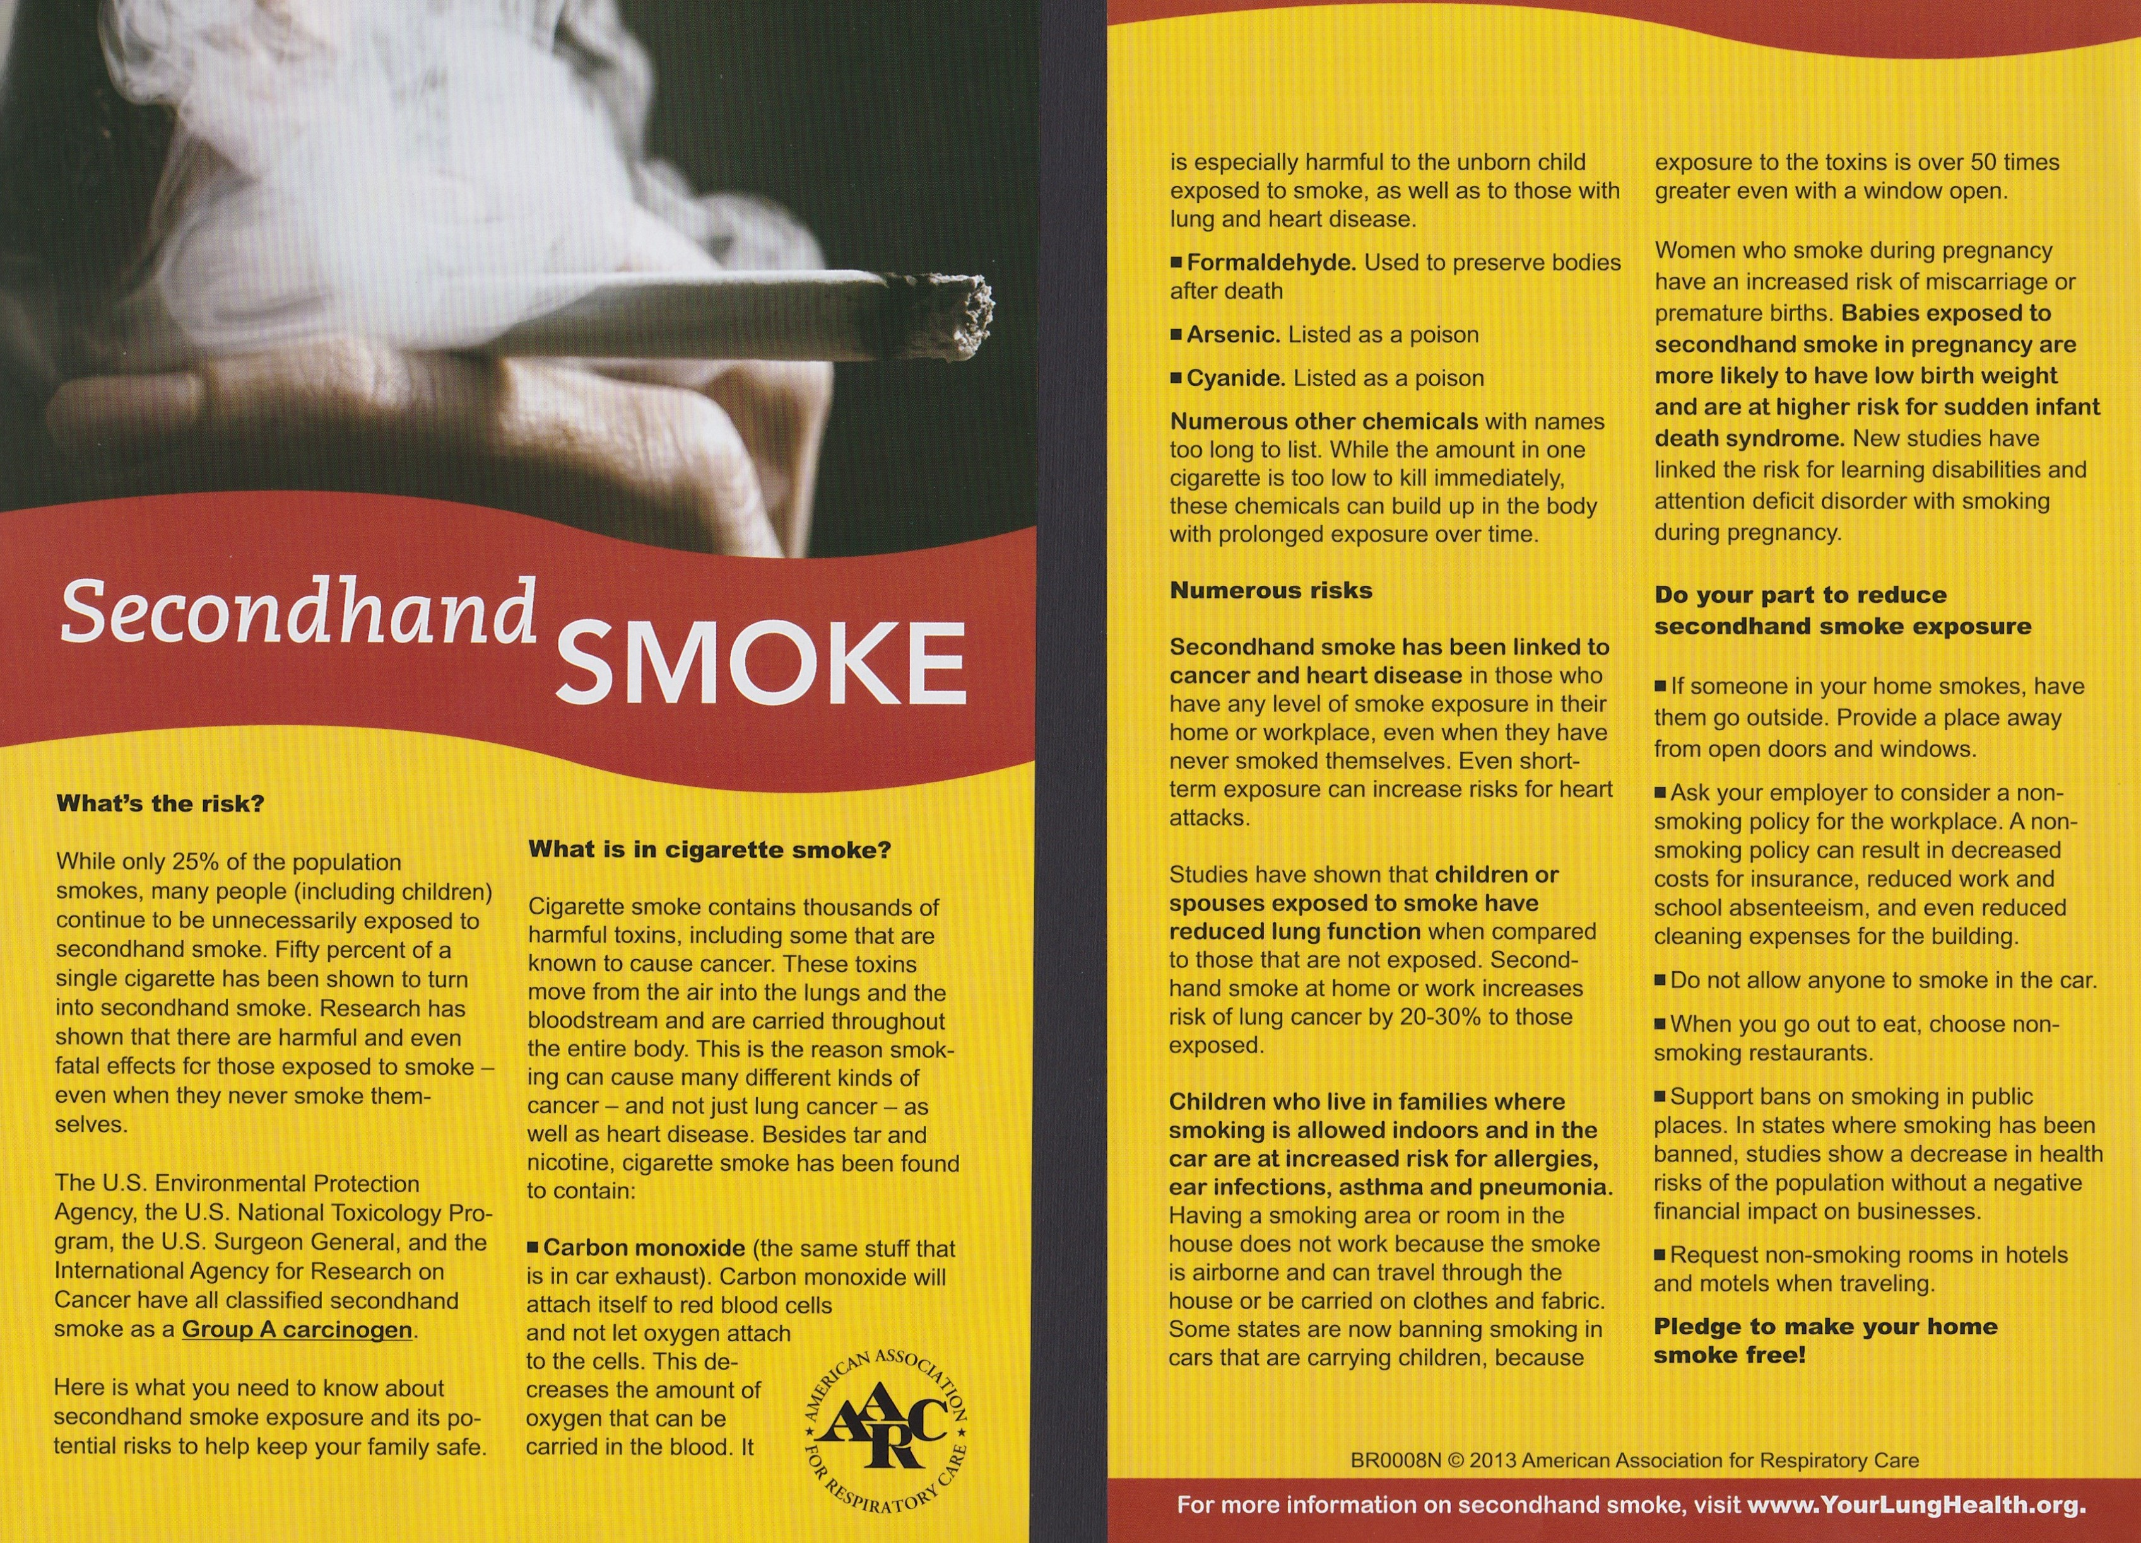
Brochures

Slide 8
Front Page
(Back Page on next slide)
Simply “cut and paste” onto WORD document
NOTE: This screener is available in duplicate form

Slide 9
Note to Doctor/Healthcare Provider: The COPD Population Screener™ (COPD-PS™) on the reverse side of this page is an easy-to-use, validated tool designed to identify patients at risk for COPD.
The COPD-PS™ has been validated in a diverse population age 35 and older
The five questions in the COPD-PS™, culled from a 52-question initial survey, were found to be the most likely to predict COPD
The study’s predictive value is 0.59 (AUC) with 88% of COPD cases correctly classified
A clinical diagnosis of COPD should be confirmed with spirometry
Please visit DRIVE4COPD.COM to learn more about this screener and its validation
About the score:
Score 5-10 — High risk of COPD
Score 0-4 — Low risk of COPD
Back Page
Simply “cut and paste” onto WORD document

Slide 10
Form for spirometry COPD screening
Simply “cut and paste” onto WORD document

Slide 11
Questions?
Marshall.post@encompasshealth.com
Or click the link on website
KRCS.org

